Slide 1
Employee Performance Analysis Using Excel
STUDENT NAME: MAMTHA KUMARI H
REGISTER NO:asunm1475312214731
DEPARTMENT:COMMERCE(ACCONTING AND FINANCE)
COLLEGE:SRI KANYAKA PARAESWARI ARTS AND SCIENCE
COLLEGE FOR WOMEN

Slide 2
PROJECT TITLE
Employee Performance Analysis Using Excel

Slide 3
AGENDA
1.Problem Statement
2. Project Overview
3.End Users
4.Our Solution and Proposition
5. Dataset Description
6. Modelling Approach
7. Results and Discussion
8.Conclusion

Slide 4
PROBLEM STATEMENT
The current process for analyzing employee statements is fragmented and lacks a systematic approach. As a result:
•Key trends and issues identified in employee feedback are not effectively captured or acted upon.
•There is insufficient correlation between employee feedback and organizational changes, leading to a potential disconnect between employee needs and management actions.
•Decision-making is hindered by the absence of comprehensive insights derived from employee statements.
▪ To develop a systematic approach for analyzing employee statements to identify key trends, concerns, and areas for improvement
•To enhance the correlation between employee feedback and organizational policies or practices.

Slide 5
PROJECT OVERVIEW
This project will review current salary data, compare it with market benchmarks, and assess internal pay equity. The analysis will cover all employee roles, departments, and levels within the organization.Key Activities:Data Collection:Gather current salary information, including base pay, bonuses, and benefits.Collect demographic details such as job titles, departments, and tenure.Data Analysis:Compare Salaries: Check how current salaries stack up against industry benchmarks and market rates.Assess Equity: Look for pay disparities across different job roles, departments, and employee demographics.Trend Analysis: Examine salary trends over time to identify patterns and anomalies.

Slide 6
WHO ARE THE END USERS?
• Human Resources (HR) Team
• Employees
•Management Team
• FinanceDepartment
• Executives/Leadership

Slide 7
OUR SOLUTION AND ITS VALUE PROPOSITION
Problem: Many companies struggle with managing and analyzing employee salaries effectively, leading to issues like inequities, compliance problems, and inefficient budget allocations.
Solution: Our solution, [Solution Name], provides an easy-to-use platform for analyzing and managing employee salaries. It simplifies data collection, automates salary benchmarking, and generates insightful reports.
Value Proposition: With [Solution Name], you can quickly identify pay disparities, ensure compliance with compensation regulations, and optimize your salary budget. This leads to fairer pay practices, reduced administrative overhead, and more informed decision-making.

Slide 8
DATASET DESCRIPTION
Scope: This dataset encompasses salary information, job titles, departments, and demographic details of employees across different locations and job functions
Data Fields:
•Employee_ID:Unique identifier assigned to each employee.
•Salary: Annual gross salary of the employee.•Job_Title: Title of the employee’s position.
•Department: Department in which the employee works.•Location: Geographic location or office where the employee is based.
•Years_at_Company: Number of years the employee has been with the company.
•Education_Level: Highest level of education attained by the employee.
•Gender: Gender of the employee (optional and anonymized for privacy)

Slide 9
MODELLING
• Data Collection
• Data Preparation
• Exploratory Data Analysis (EDA)
•Modeling and Analysis
•Benchmarking
• Reporting and Visualization
• Implementation and Monitoring

Slide 10
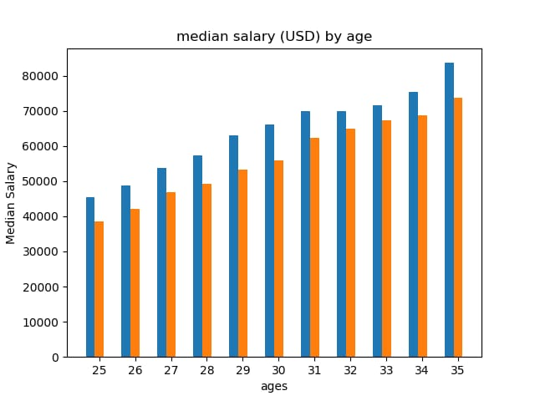
RESULTS

Slide 11
CONCLUSION
conclusionAnalyzing employee salaries helps ensure fair and competitive pay, align compensation with performance, manage costs effectively, and support diversity. This approach not only attracts and retains talent but also promotes a positive and equitable work environment.
•Ensure Fair Pay: Make sure everyone is paid fairly for their work.
•Stay Competitive: Keep salaries in line with what others are paying to attract and keep the best talent.
•Reward Performance: Link pay to how well employees perform to motivate and reward them.
•Manage Budgets: Control payroll costs effectively while staying within budget.

